Slide 1


Serverless Holiday Hackathon 2023

Slide 2



Our plans for today
About Serverless Guru
LLM Crash Course!
AWS LLM Ecosystem
Q & A

Slide 3
About Serverless Guru
Your Guide to Serverless Adopt. Migrate. Build.

Slide 4
Our Company
We love to take on challenges, face the unknown, and be on the forefront of serverless innovation.
Helping companies and people realize their full potential gives us energy.
Speak to a Guru today!

Slide 5
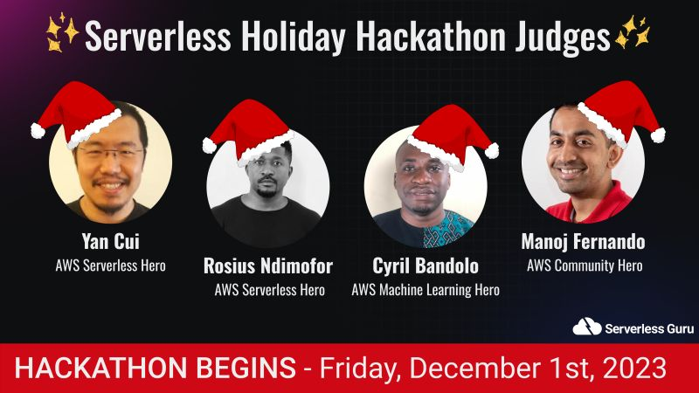

Slide 6
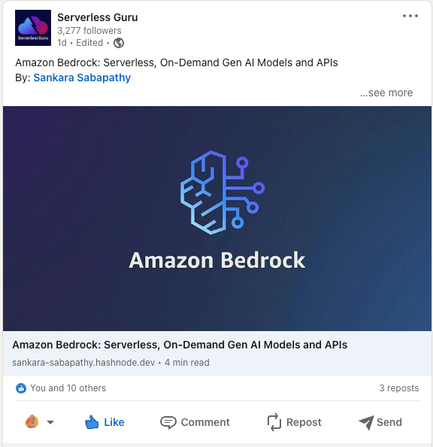

Slide 7
LLM Crash Course
Everything you need to know
to get the most out of LLMs

Slide 8
AWS LLM Ecosystem
Bedrock is a Minecraft thing? Right?

Slide 9
Amazon Bedrock
Definition: Amazon Bedrock is a fully managed service that offers a choice of high-performing foundation models … via a single API.
Models Available
LLM: Llama 2, Claude, Titan
Text-To-Image: Stable Diffusion, Titan (again)
Demo Video
Notes:
Llama 2 - July 2023 (Meta)
Claude - March 2023 (Anthropic)
Titan - Sept 2023 (Amazon)
Stab-diff 2022

Slide 10
Amazon Bedrock
Definition: Amazon Bedrock is a fully managed service that offers a choice of high-performing foundation models … via a single API.
Managed / Serverless
No infrastructure to maintain (but must acquire model access) and $ per token pricing model.

Slide 11
Amazon Bedrock
Definition: Amazon Bedrock is a fully managed service that offers a choice of high-performing foundation models … via a single API.
Accessible via AWS API
InvokeModel
InvokeModelWithResponseStream
InvokeAgent

Slide 12
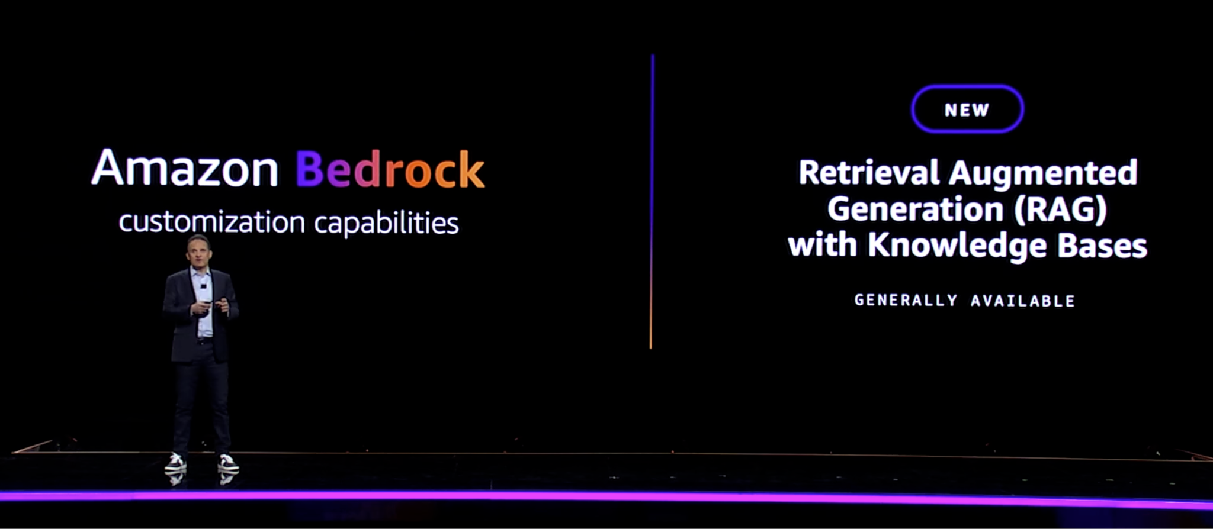
Bedrock Knowledge Base
RAG Reaches AWS!
Generally Available 28th November 2023
Ingests data (S3) into vector database
Think custom GPTs from OpenAI
Notes:
RAG - AI framework for retrieving facts from external knowledge bases.

Slide 13
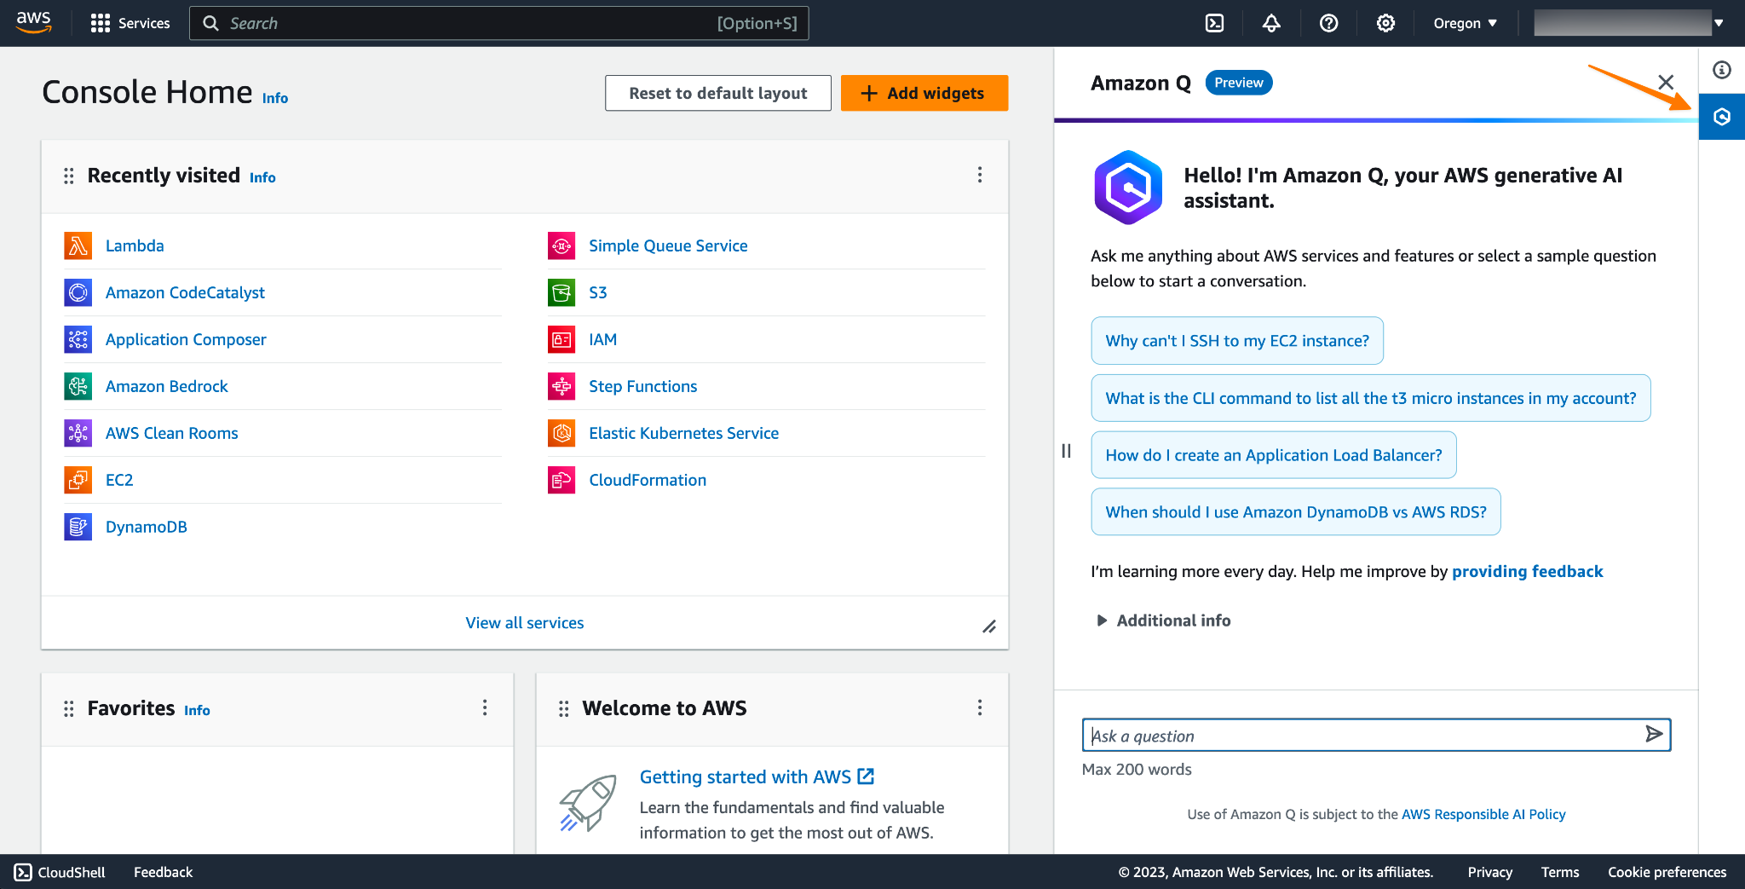
Bedrock Knowledge Base
RAG Reaches AWS!
Notes:
RAG - AI framework for retrieving facts from external knowledge bases.

Slide 14
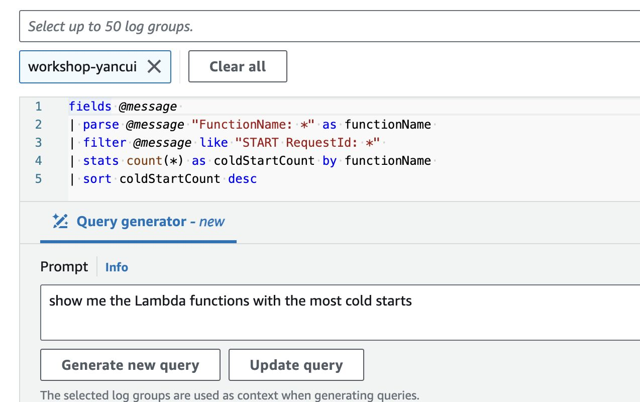
Bedrock Knowledge Base
RAG Reaches AWS!
Notes:
RAG - AI framework for retrieving facts from external knowledge bases.

Slide 15
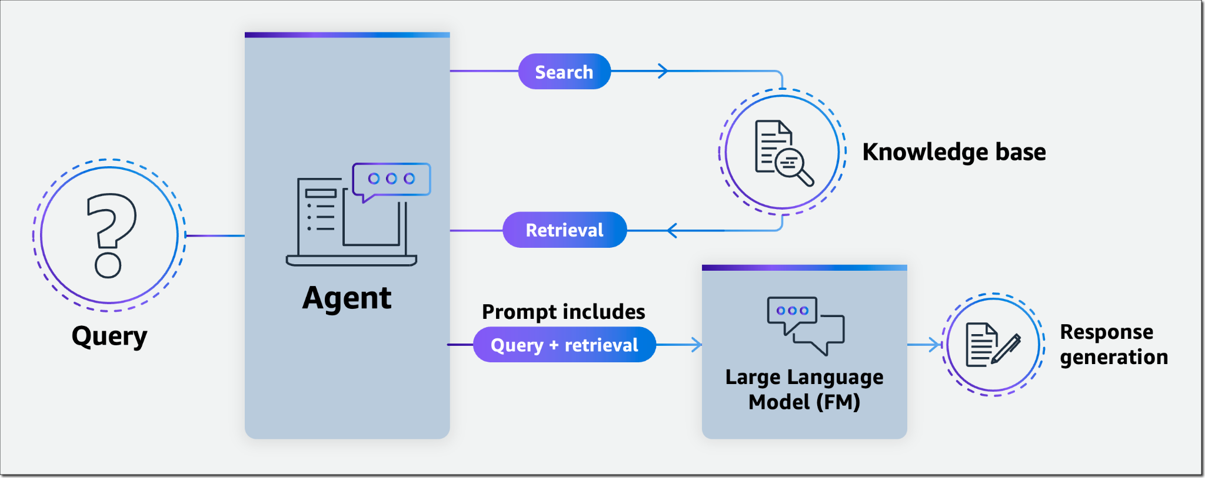
Bedrock Agents
Developer Help At Last!
Generally Available 28th November 2023
Access to private resources (via knowledge base)
Maintains a conversation chain/context
Think LangChain “ConversationChain”
Notes:
InvokeModel
InvokeModelWithResponseStream
InvokeAgent

Slide 16



Time for
Demo.

Slide 17
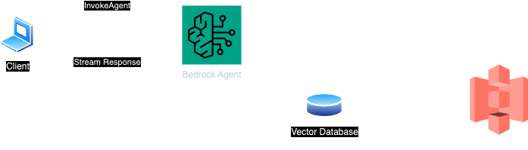

Slide 18
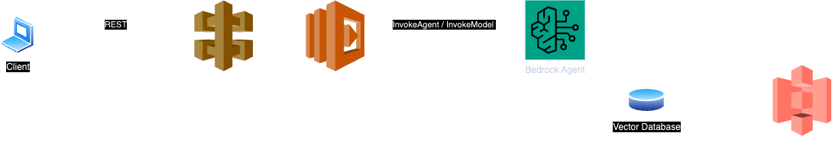

Slide 19
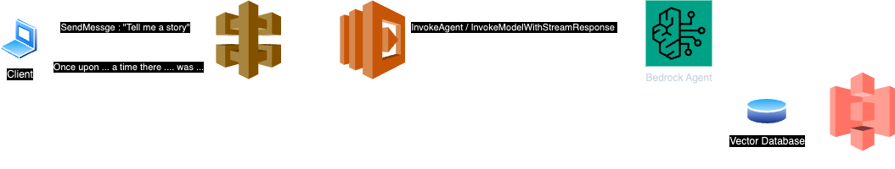

Slide 20
Questions & Answers

Slide 21


Thank you!
Join our discord Server!
Sign up for the challenge!

